Slide 1
Warranty Flag “OZ “Usage Guide (Apr. 2019)
1. Warranty Flag OZ usage guide (Apply to all SVC types)
- Use Warranty flag “OZ”, When we didn’t get paid for what was categorized OOW (Because of customer’s fault or environment impact)
Defect Cause type | Category
Customer’s fault
Other devices problem
Environment
other
Product damage caused by external impact
defects due to liquid phase inflow
not inserted power cord
Service request after loss of installer material
misuse of detergent
As-Is
To-Be
External Cable fault such as HDMI (TV work fine)
Defects of external device such as set-top,
satellite,Sound Bar, power outlet (TV work fine)
Application(Netflix, YouTube, etc) rest or
reinstallation, update
IW
OZ
Defects by degradation of broadcast or
internet signal quality
electricity / gas supply problem in House
Fire/Electric problems (around home)
Valve/ducts/plumbing problem
Defects caused by foreign matter
such as insects inside the product
the repair cancellation after submission of
the repair cost estimate
The repair was canceled because the customer
could not be contacted
2. The sample cases by category which warranty Flag “OZ “ should be used
TV/Monitor/CAV Product : 2/4 page,
REF/WM/Dryer : 3/4 page,
MWO/Range/Dishwasher/RAC : 4/4 page
RAC : 5/5 page
1 / 5

Slide 2
Warranty Flag Usage Standard Guide (Apr. 2019)
2. The sample cases which warranty Flag “OZ“ should be used
1) TV/Monitor product
SVC Type | Warranty Flag code | Defect Cause Type | Category | Sample repair data (ASC or Tech Remark)
IH CI CD PD SS RP FT RS | OZ | Customer’s fault
 |  | Other Devices problem
 |  | Environment
 |  | other
product damage caused by external impact
. Module crack/scratch,
Appearance damage/scratch
- LCD panel broken by physical damaged.
- found that the lcd panel has physical impact, not covered by w’ty
- TV Problem: Bezel and LED Displey separated. Physical Damaged
- HDMI port is broken
defects due to liquid phase inflow
(inside product, remote controller)
- Unit found to have liquid damage (warranty voided)
- found water damage to the ribbon across the bottom of the screen
External cable fault such as HDMI (TV work fine)
- HDMI 2 is not work / no signal sign / HDMI cable problem
- Cable box and still no audio. Cable issue
Defects of external device such as set-top box,
Satellite, sound bar, router, power outlet, etc.
(TV work fine)
- No picture reboot cable box unit checked ok
- Customer was offered equipment upgrade from Satellite provider.
- Customer has some set up issue with Bose sound system. TV is fine
- Adjust Astro connector. Doing setting. TV no problem
- powers on issue is with customers power house outlet. Unit ok
- diag and customer ed router issues unit is working fine
Application(Netflix, YouTube, etc) rest or
reinstallation, update
- Restore Amazon Apps operation. All working ok now
- Had client do a 2 min reset and then the update apps
Defects by degradation of broadcast or internet
signal quality
- air signal not strong enough
- Tv is working normal within specs advised customer to contact
cable company
- Educated customer to either use less devices or to contact
their service provider to increase bandwidth
Defects caused by foreign matter such as
insects inside the product
- Unit is infested with roaches warranty void
- Service checking (defected by cat’s urine)
The repair cancellation after submission of
the repair cost estimate
The repair is canceled because the customer
could not be contacted
- diagnotics only - estimate refused for repair
- No part needed//2//Not home. Called several times
- Claims he disposed of the wrong TV when moving
because he is blind
※ How to check the defect caused by liquid of TV Remoter Controller : refer to Attachment 1~4 page
2 / 5

Slide 3
Warranty Flag Usage Standard Guide (Apr. 2019)
2) Ref
SVC Type | Warranty Flag code | Defect Type | Category | Sample data which warranty flag “OZ” should be used
IH CI CD PD SS RP FT RS | OZ | Customer’s fault | Damage from customer’s fault | - Dent, Scratch, Blemish, Flaw, Replace door
 |  | Environment | Customer Environment Case - electrical problems, customer house Valve problems | - defective outlet - fire in area there was a power outage - wanted doors reversed - copper supply line is broken
 |  | other | Do not connect the housing due to installation fault | - Miss connected during delivery & Installation
 |  |  | Damage and not assembled due to installation fault | - Delivery damage, Damage by installer
3) W/M and Dryer
SVC Type | Warranty Flag code | Defect Type | Category | Sample data which warranty flag “OZ” should be used
IH CI CD PD SS RP FT RS | OZ | Customer’s fault | customer’s fault : Not inserted power cord, Locked water tap & Gas valve, Overuse of detergent or wrong connect of Cold / hot water | Laundry is hot or warm after washing because the inlet hoses are installed in reverse. Reinstall the inlet hoses. Water is not supplied because the water tap is not turned on. Turn on the water tap. Power not supplied because of loose connection of power cord.
 |  | Environment | SVC due to customer environment, not product problem : Circuit breaker, natural disasters, ducts and plumbing problems | Power not supplied because of electrical outlet problem. Change the electrical outlet. Duct is clogged. (Not heating, long dry time) Clean the hood and duct. Damage to the product caused by accidents, pests and vermin, lightning, wind, fire, floods, or acts of God.
 |  | other | Door Reverse request Unremoved Tranist bolts, Base Packing Maintenance product : Cleaning water /drain/drier filter or dirty in gasket, | Door Reversal. Strange vibration or noise caused by not removing shipping bolts or tub support. Remove the shipping bolts & tub support. Leakage caused by dirt (hair, lint) on seal and door glas. Cean the seal & door glass. Not draining caused by clogging of pump filter. Clean the pump filter Clean the inlet valve filter, reinstall the water inlet hoses. Clean the detergent dispenser drawer.
3 / 5

Slide 4
Warranty Flag Usage Standard Guide (Apr. 2019)
4) MWO / Range / Dishwasher product
SVC Type | Warranty Flag code | Defect Type | Category | Sample data which warranty flag “OZ” should be used
IH CI CD PD SS RP FT RS | OZ | Customer’s fault
 |  | Other device
 |  | Environment
 |  | other
Product damage due to external impact
ex. F.cover, Panel crack/scratch, Appearance damage
-(MWO)BROKEN DOOR GLASS ORDER DOOR ASSY DOOR ASSY REPLACED GLASS DOOR ON MICROWAVE
-(Range)top glass shatter for some reason. heating elements are broken. not covered by warranty
due to the physical damage.
-(Range)Unit has cracked cooktop. Contacted LG tech support. Through telepresence app tech
support was able to see cooktop cracks and deemed it not covered (physical damage).
-(Range)physical damage at glass top glass top had scratches . Replaced part educated customer
regarding LG policies for cosmetic warranty
-(DW)Replaced damaged door handle to restore operation. Door handle scratched.
-(DW) REPLACED DAMAGED OUTER DOOR SKIN DRAIN HOSE AND MISSING TUB MOUNTS. RAN
THRU CYCLES NO OTHER PROBLEMS FOUND.
Damage / Poor operation due to customer misuse
ex) NA Range Nozzle Broken, Dishwasher misuse of detergent
-(Range) THE TECH REPLACED THE LP ORIFICES TO NATURAL. THE GAS REGULATOR WAS ALSO
SWITCHED TO NATURAL. THE UNIT WAS TESTED AND WORKING PROPERLY AFTER THE REPAIR.
-(DW) THE DOOR WAS NOT ALIGNED PROPERLY. ALSO TOLD CUSTOMER TO USE RINSE AID.
Installation material request due to customer error
ex) Service request after loss of installer material
-(DW) MISSING BRACKETS. REPLACED PARTS AND TESTED ALL OPS OK.
non-manufacturing manufacturer SVC
-(DW) Apon arrival another company there fixing unit ..service not needed
SVC due to customer environment, not product problem
ex1) electricity / gas supply problem in House
ex2) Fire/Electric problems around the customer's home
ex3 ) Customer house principal valve problem (water supply defect)
-(Range) UNIT NOT TURNING ON ONLY 120V TO OUTLET NEEDS 240V CUST NEEDS AN ELECTRICIAN
-(Range) Cx edu that they need to Reduce the gas pressure. Gas regulators and safety valve ok .
making noise due to cx gas pressure too high
-(DW) FOUND POWER ISSUE WITH UNIT NOT GETTING PROPER VOLTAGE ADVI SED CUST
-(DW) Unit not turning on. Found unit not properly wired to outlet. Fixed and tested. All operations check good.
-(DW) Not getting enough water found water valve not open enough turned water valve open
unit now getting water correctly.
Defect caused by foreign substances such as bugs inside the product
-(DW) Took dishwasher out found mice had chewed wire harness not covered by warranty
The customer canceled the repair after submitting the repair cost estimate
The repair was canceled because we couldn't contact the customer for
a long time.
-Visit customer home no one at home contact customer he is in Florida. Wants reschedule this Wed afternoon
Customer used new detergent recommend by tech now unit has worked ok
- CALLED CUSTOMER. WENT OVER THERE NO ANSWER AT THE DOOR.
4 / 5

Slide 5
Warranty Flag Usage Standard Guide (Apr. 2019)
5) RAC product
SVC Type | Warranty Flag code | Defect Type | Category | Sample data which warranty flag “OZ” should be used
IH CI CD PD SS RP FT RS | OZ | Customer’s fault | Damage from customer’s fault ex) Indoor / out door unit - Scratches, appearance damage, Dent | - Unit have physical damaged. - Unit was dropped by shipping - arrived damaged - Unit is physically damaged cause incorrect operate
 |  |  | Customer malfunction and customer carelessness (ex. no power connection / ventilation) | - Customer malfunction and customer carelessness (no power connection / ventilation)
 |  |  | Request free replacement of maintenance parts ex) When a free replacement is required for a filter whose replacement cycle has elapsed | - Free replacement for filters (Replacement cycle has expired)
 |  | Environment | SVC due to customer environment, not product problem - Power supply interruption due to voltage fluctuation - Insufficient capacity of circuit breaker - Natural disasters | - Unit works on battery but not AC power - Under capacity of circuit breaker - Defect by a convulsion of nature - Defect by Incorrect Voltage - Unstable Voltage (Hi/Low)
 |  |  | Defects caused by foreign matter such as internal worms and lizards | - Foreign object., Insect, lizard
 |  | other | - Decreased capacity due to wrong selection of cooling & heating capacity - Damage and not assembled due to installation fault - Proactive SVC (Pre-check SVC) - | - Wrong selection of Air conditioner Capacity - Damage by installer - Breaks down after time not related with temperature - Proactive SVC (Pre-check SVC)
5 / 5

Slide 6
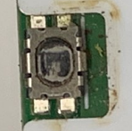
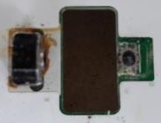
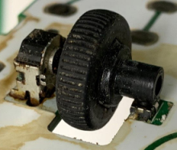
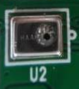
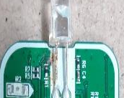
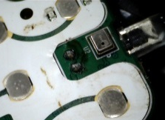
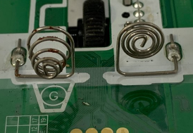
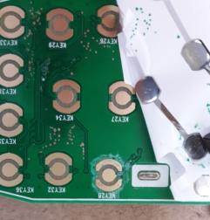
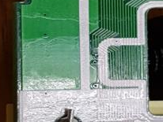
Attachment. How to check the defect caused by liquid of TV Remoter Controller
1. Symptoms : Remote control not powered, key malfunction, voice recognition failure
[Remote Control Disassembly Method]
2. Cause : Liquid phase enters the Magic remote control, causing corrosion of
internal components (short)
- Liquid phase in the wheel area and the MIC area (water, beverage, soup, etc.)
※ Refer to attachment2 1/3~3/3 page
3. How to check the defect caused by liquid
① Open the battery cover
② Place knife between top case and bottom case
③ Please twist knife left and right to open latch wealth. (Latch wealth : 12 Point)
④ Separate the Top case, Rubber, PCB Ass’y bottom case, and check the liquid flow
with your naked eye.
⑤ The liquid is concentrated in the wheel and the MIC area, so check
the area surrounding the area closely.
⑥ Also, peel off metal dome sheet (white) to check liquid inflow and PCB corrosion
4. liquid inflow case
location | photo 1 | photo 2 | photo 3
Wheel (PCB Center)
MIC (PCB Top)
PCB
tact switch contamination
Encoder contamination
Wheel contamination
MIC contamination
IR LED lead corrosion
MIC contamination
spring corrosion
PCB copper corrosion
PCB contamination
Attachment 1

Slide 7
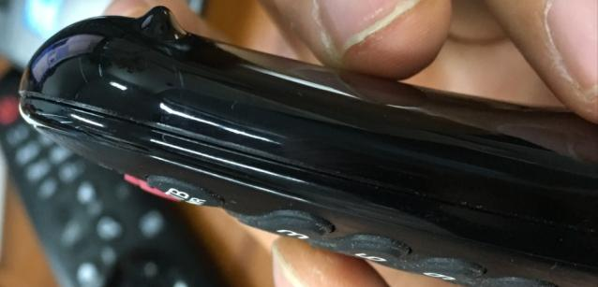
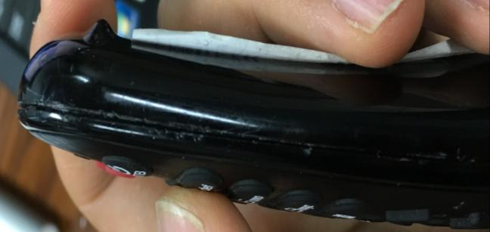
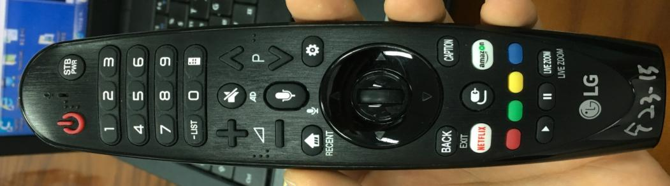
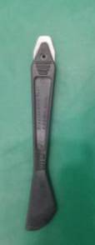
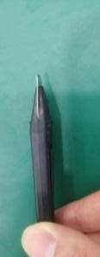
Attachment. Remote Control Disassembly Method(1/3)
1. Check the gap between top case and bottom case
Bottom Case
Gap
Top Case
[Where there is no gap ] : Difficult to break down
[Where there is a gap ] : easy to break down
2. Select the latch part to insert the jig for dismantling in case there is no gap
- It is easy to disassemble if you choose No. 1 or No. 2.
(Hold the remote control with one hand and disassemble using a table or other object)
① ~ ⑫ : Latch
②
③
④
⑤
①
⑥
⑫
⑦
⑪
⑩
⑨
⑧
[Magic remote controller Latch Point]
[disassembly jig ]
Attachment 2

Slide 8
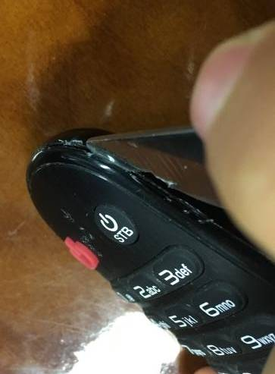
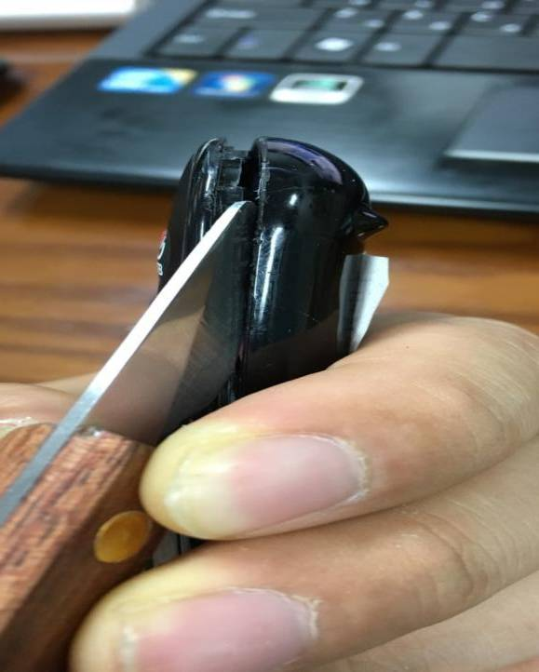
Attachment. Remote Control Disassembly Method(2/3)
3. Insert the disassembly jig between the gap between the top case and the bottom case.
Inserting a jig for disassembly into the latch section to open the gap
Jig
Gap
Jig
[Insert the jig for disassembly into the gap ]
[open a gap after a jig is inserted ]
Attachment 3

Slide 9
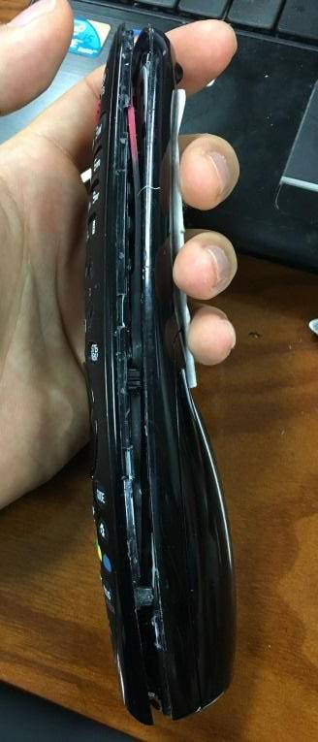
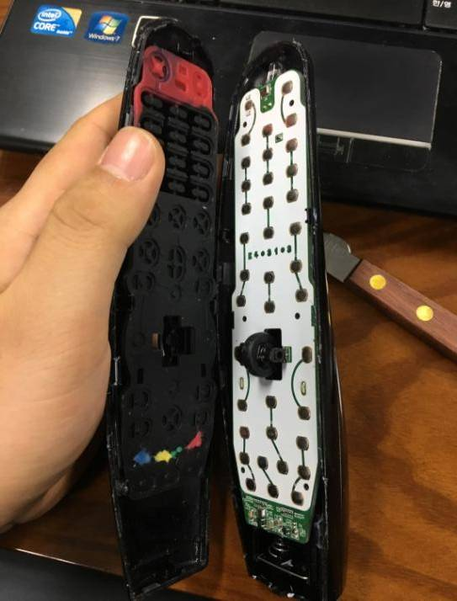
Attachment. Remote Control Disassembly Method(3/3)
4. Open the remaining latches in turn clockwise or counterclockwise direction
[a state in which one side is open]
[Remote control release completed ]
Attachment 4

Slide 10
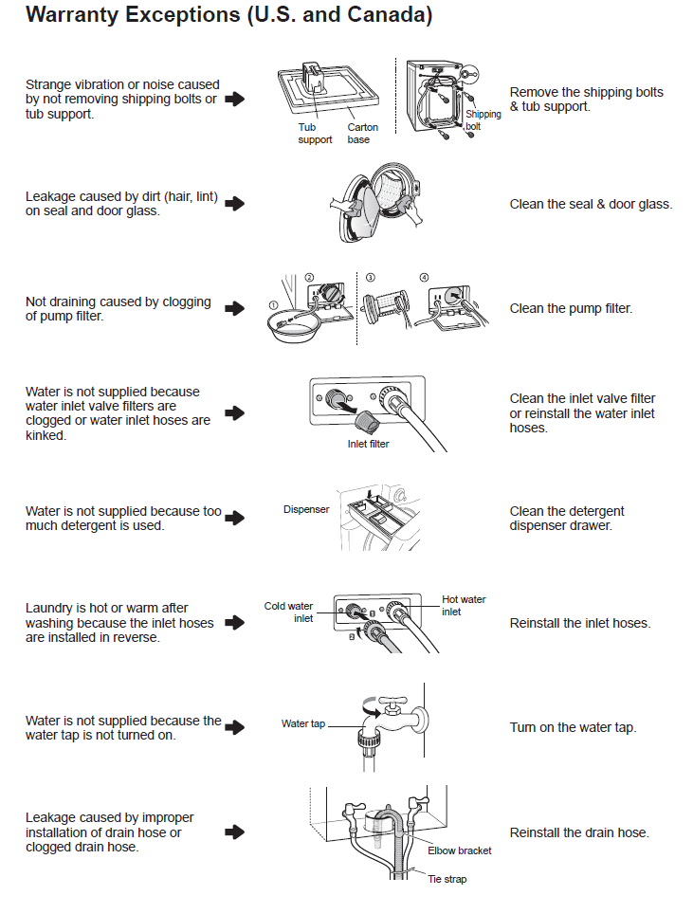
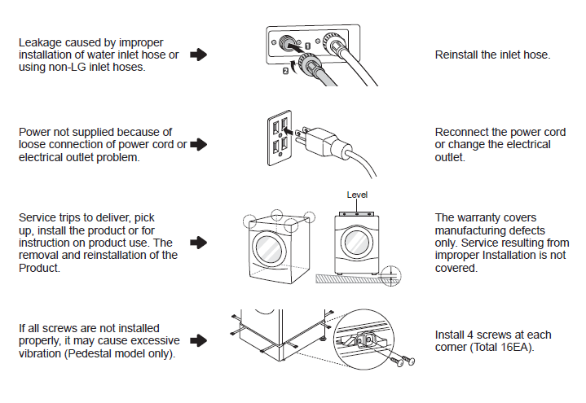
Attachment. Not Covered Warranty Case for W/M and Dryer
Front Loader

Slide 11
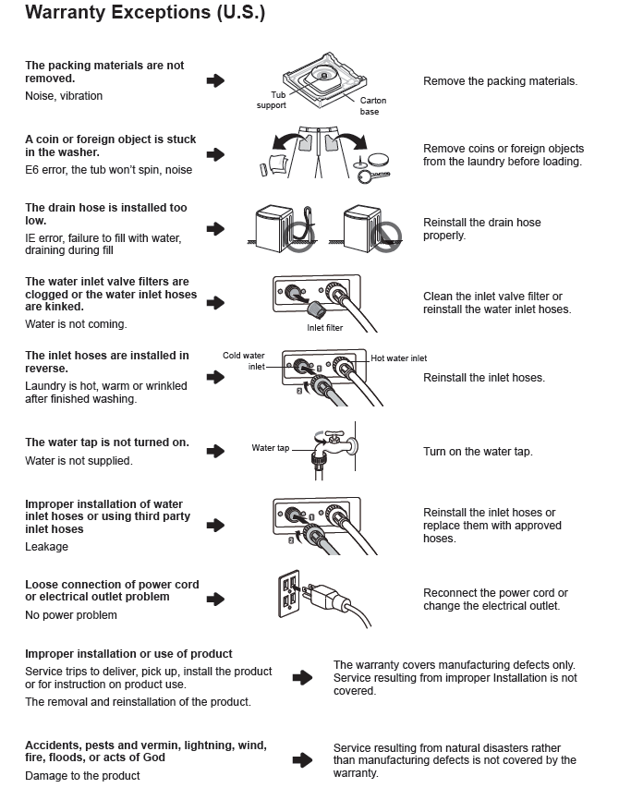
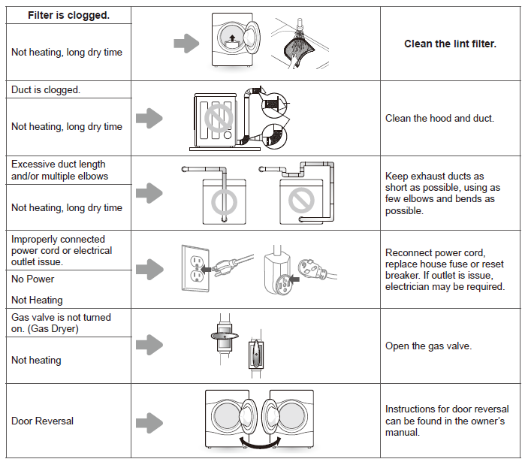
Attachment. Not Covered Warranty Case for W/M and Dryer
Top Loader
Dryer

